Slide 1
Data project: Business Bank
Holly Lewis-Frayne
Code First Girls: Intro to Data and SQL
July 2021

Slide 2
Project idea: Investing in Women
Investing in Women is a project that I did for my work that was the beginning of my interest in data.
The purpose of the project was to find out whether banks with more women in leadership roles were better at lending to women-led businesses.
I wasn’t able to answer this question as banks don’t collect gender disaggregated data for their business loan clients.
For my project, I decided to make a database for a Business Bank that does record this data.

Slide 3
The Database: tables
Bank Employees – data relating to the bank’s employees such as name, salary, and gender
Business Accounts – data relating to all of the bank’s business accounts, such as account numbers and sort codes
Business Owners – data relating to owners of the bank’s business accounts, such as name, gender, and whether they are the main contact for the account
Loan Applications – data relating to the loan applications that the bank receives, such as who is making the application and the amount requested
Business Regulator – data relating to the registration of a business, such as name and turnover
Loan Application Employee Check – data relating to the processing of loan applications by the bank’s employees

Slide 4
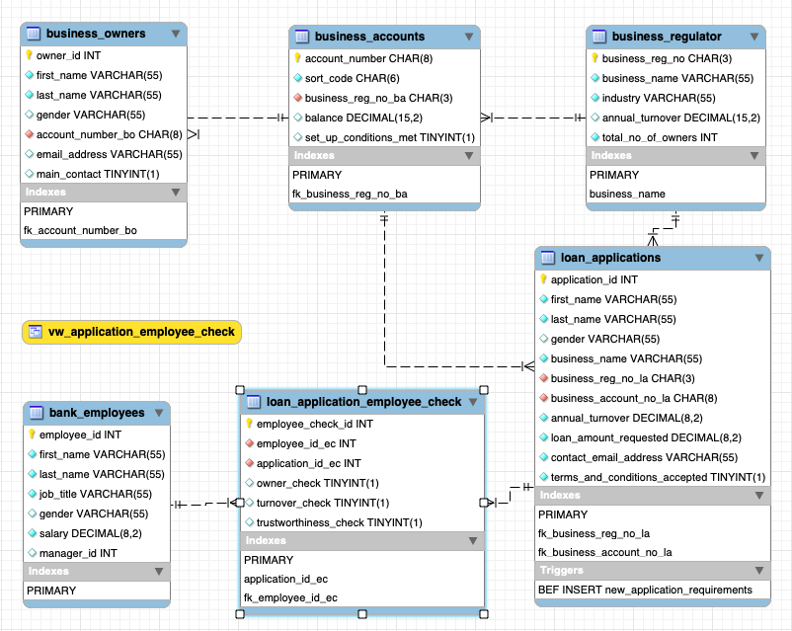

Slide 5
How it works
Account holders wishing to take out a loan must submit a form that meets the minimum requirements (loan under £25k and terms and conditions accepted).
Sproc to facilitate inserting data into the Loan Applications table.
Trigger logs an error and does not update the table if either of these conditions are not met.
An employee will then pick up the application and determine: i) if the details match the bank’s records, ii) if the details match the Business Regulator’s records, iii) if they consider the application to be trustworthy.
View consisting of a join of the Loan Application, Business Regulator and Bank Account tables provides all of the information needed for the first two checks.
Function to set the status of the application as Approved or Rejected if any of the checks are failed.

Slide 6
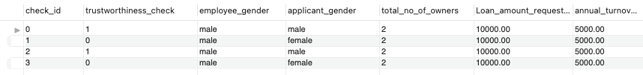
Data analysis
Join of five tables: Bank Employees, Business Owners, Loan Applications, Business Regulator, and Loan Application Employee Check.
Returns all loan applications, the amount requested, the business’s annual turnover, the total number of owners, the gender of the employee conducting the check, the gender of the applicant and whether they have passed the trust worthiness check.

